Slide 1
Orange Services IT Bootcamp
AI Workshop
Intro in Artificial Intelligence & ML
Andrei Gabriel Popescu ~ Data Scientist
Bogdan Marian Cazan ~ Data Engineer

Slide 2
Content
Short recap
--- Andrei
Classification
Code session
--- Bogdan
Regression
Code session
- Assignment presentation –

Slide 3
AI Course structure
Clustering
Classification
Regression
Intro to NN (neural networks) w/ PyTorch
- The optional assignment is on!!
Generative models
Anomaly detection - use case
- The optional assignment presentation!
For questions you can contact me:
- Andrei.popescu@orange.com

Slide 4
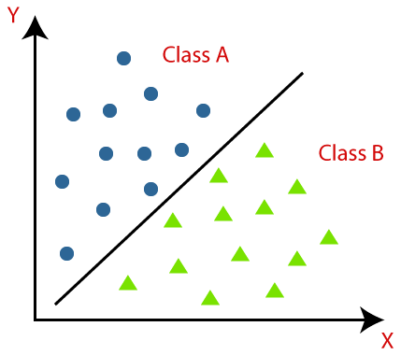
Classification
-Classification is a supervised machine learning method where the model tries to predict the correct label of a given input data.
In classification, the model is fully trained using the training data, and then it is evaluated on test data before being used to perform prediction on new unseen data.
K-NN, SVM, Logistic Regression etc.

Slide 5
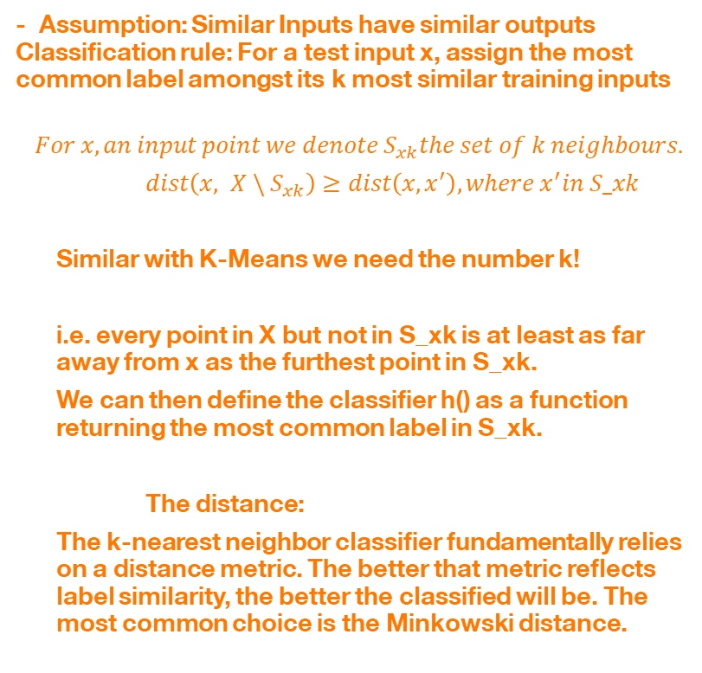
Classification
- Assumption: Similar Inputs have similar outputs Classification rule: For a test input x, assign the most common label amongst its k most similar training inputs
$$For x, an input point we denote S_{xk}the set of k neighbours.$$
$dist\left(x, X \backslash S_{xk}\right)≥dist\left(x, x^{′}\right), where x^{′}in S_xk$
Similar with K-Means we need the number k!
i.e. every point in X but not in S_xk is at least as far away from x as the furthest point in S_xk.
We can then define the classifier h() as a function returning the most common label in S_xk.
The distance:
The k-nearest neighbor classifier fundamentally relies on a distance metric. The better that metric reflects label similarity, the better the classified will be. The most common choice is the Minkowski distance.
K-NN, SVM, Logistic Regression etc.

Slide 6
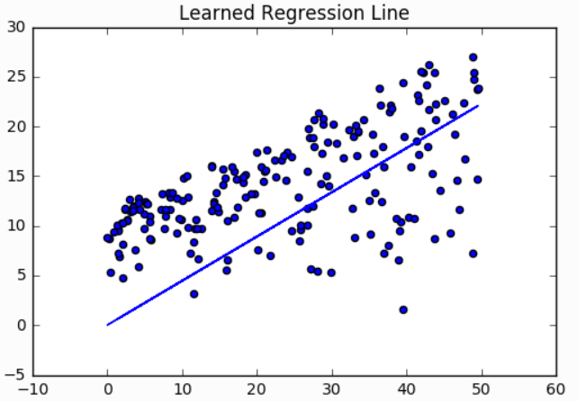
Regression
- Linear Regression is a supervised machine learning algorithm where the predicted output is continuous and has a constant slope.
- It’s used to predict values within a continuous range, (e.g. sales, price) rather than trying to classify them into categories (e.g. cat, dog). There are two main types: simple regression and multiple regression.
Linear Regression

Slide 7
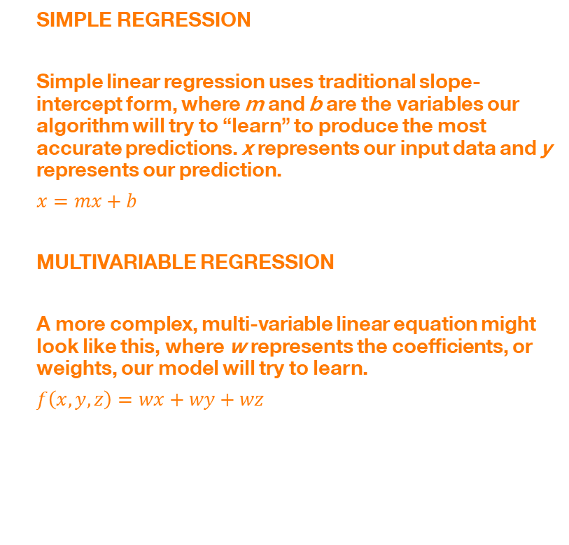
Regression
SIMPLE REGRESSION
Simple linear regression uses traditional slope-intercept form, where m and b are the variables our algorithm will try to “learn” to produce the most accurate predictions. x represents our input data and y represents our prediction.
$x=mx+b$
MULTIVARIABLE REGRESSION
A more complex, multi-variable linear equation might look like this, where w represents the coefficients, or weights, our model will try to learn.
$f\left(x,y,z\right)=wx+wy+wz$
Linear Regression

Slide 8
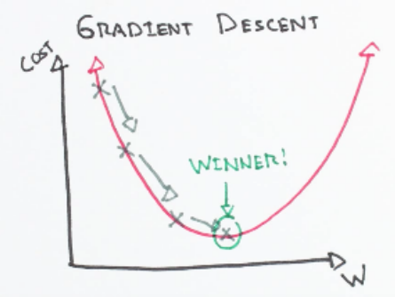
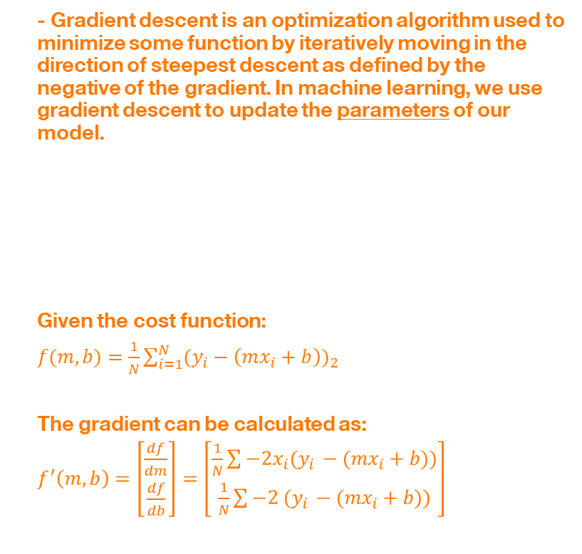
Gradient Descent
- Gradient descent is an optimization algorithm used to minimize some function by iteratively moving in the direction of steepest descent as defined by the negative of the gradient. In machine learning, we use gradient descent to update the parameters of our model.
Given the cost function:
$f(m,b)=\frac{1}{N}\sum_{i=1}^{N}{{(y_{i}−\left(mx_{i}+b\right))}_{2}}$
The gradient can be calculated as:
$f^{′}\left(m,b\right)=\left[\begin{aligned}\frac{df}{dm} \\ \frac{df}{db}\end{aligned}\right]=\left[\begin{aligned}\frac{1}{N}\sum{−2x_{i}(y_{i }−(mx_{i}+b))} \\ \frac{1}{N}\sum{−2 (y_{i }−(mx_{i}+b))}\end{aligned}\right]$
Linear Regression

Slide 9
Thanks

